Slide 1
2018
Notes:
When reviewing this training prior to delivering to installation leadership, feel free to prepare local / installation notes and facts.
The purpose of this brief is to communicate important EFMP information and share community-specific demographics, resources, and accomplishments with installation leadership.

Slide 2
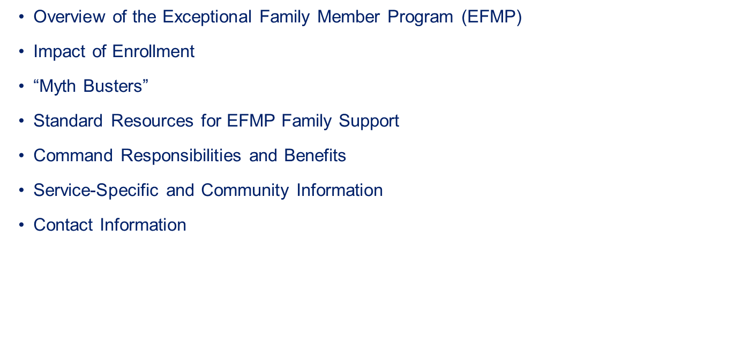
Notes:
During this brief, we will review the purpose and impact of the Exceptional Family Member Program (EFMP), dispel key program misconceptions or “myths” that currently exist across the DoD, highlight some standard resources available for EFMP Family Support staff, and share Service-specific and community information for your reference.

Slide 3

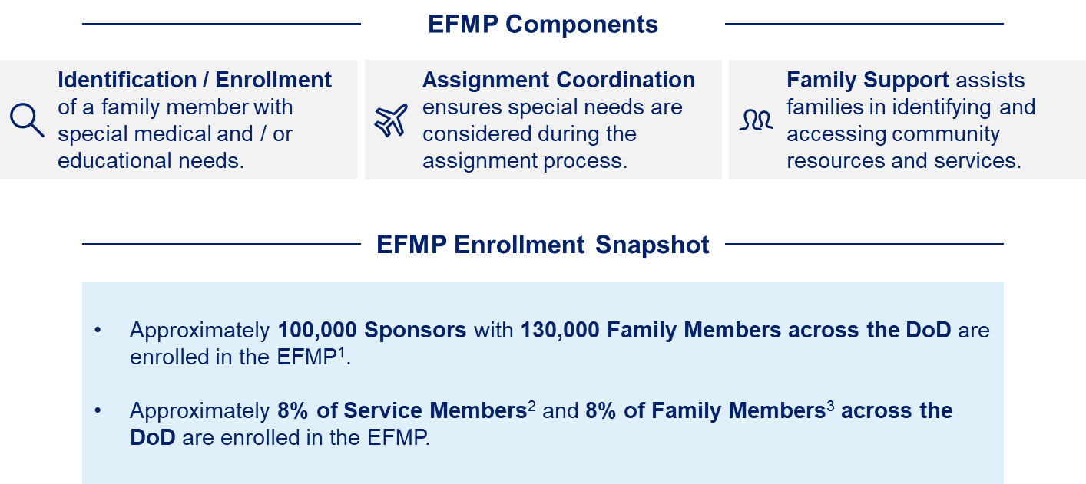
Notes:
The Exceptional Family Member Program (EFMP) supports military families with special medical and / or educational needs that meet certain criteria for mandatory enrollment and promotes personal, family and mission readiness. Family members of varying needs, ages, and relationships to sponsor (spouse, child, adult dependent) are enrolled in the EFMP.
In order to support military families with special needs, the EFMP consists of the following three Components:
Identification / Enrollment of a dependent with special medical and / or educational needs.
Assignment Coordination ensures special needs are considered during the assignment process.
Family Support assists families in identifying and accessing community resources and services. EFMP Family Support staff in installation family centers provide Information & Referral services, develop service plans, and facilitate non-clinical case management.
[Feel free to describe your Service-specific processes and responsible offices for each of the above Components.]
To better understand the EFMP population, the EFMP Enrollment Snapshot section of this slide identifies the approximate number of sponsors and family members enrolled in the EFMP. Additionally, this section identifies the approximate percentage of Service Members and Family Members across the DoD enrolled in the EFMP.
Each of the Services administers its own EFMP according to Service specific policy. The Office of Special Needs (OSN) has oversight to ensure that each of the programs operate in accordance with DoD Instructions (DoDIs) 1315.19 “The Exceptional Family Member Program”, and 1342.22 “Military Family Readiness”.

Slide 4
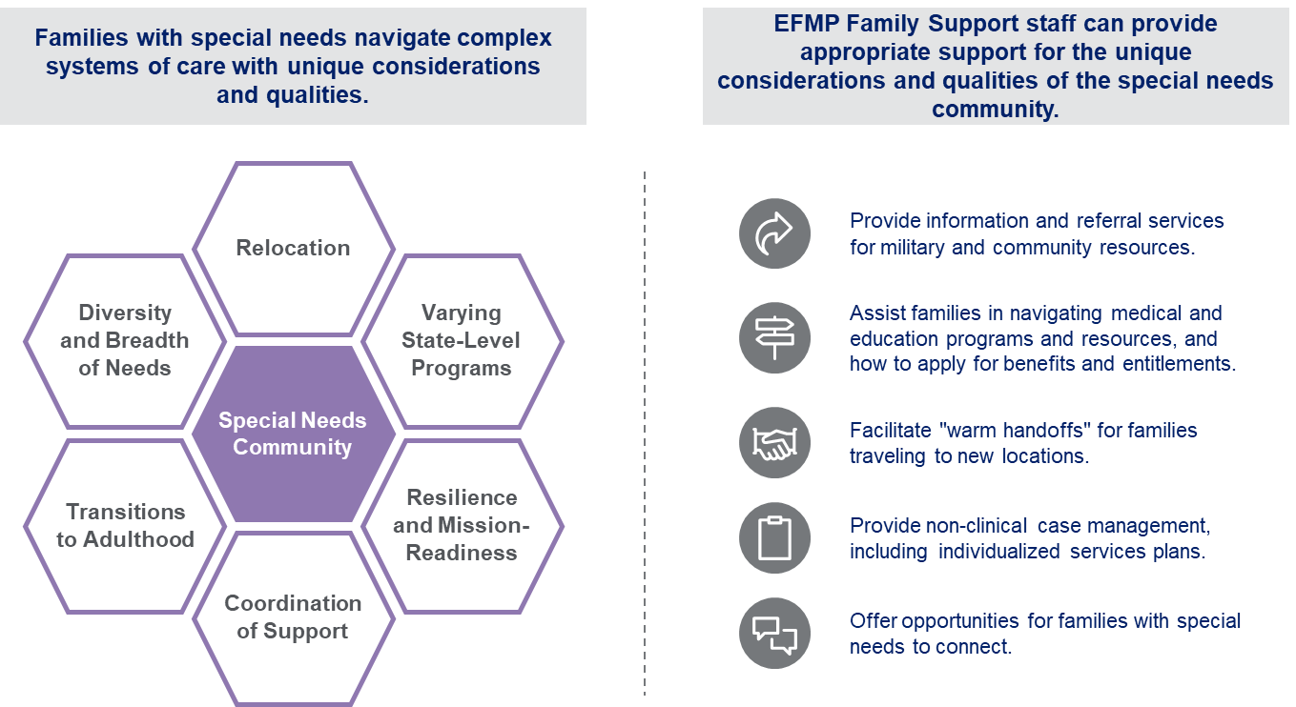
Notes:
It is important that staff at every level are aware that families enrolled in the EFMP may have experiences that require additional attention and coordination.
The graphic on the left identifies some unique considerations as families with special needs navigate complex systems of care. For example, families that receive care from several medical providers must ensure that support is coordinated at a new installation when a family has PCS orders, which is often challenging and stressful. Additionally, dependents with special needs that are transitioning to adulthood must consider potential shifts in independent living, educational and vocational opportunities, and eligibility for other support services. Our military families with special needs are resilient and mission-ready.
In order to assist families with special needs in navigating available programs and resources at the installation and in the community, the EFMP Family Support staff offer a variety of support services outlined on the right side of the slide. These support services include providing information & referral services, facilitating warm hand-offs, providing non-clinical case management, and offering opportunities for families with special needs to connect with one another.

Slide 5
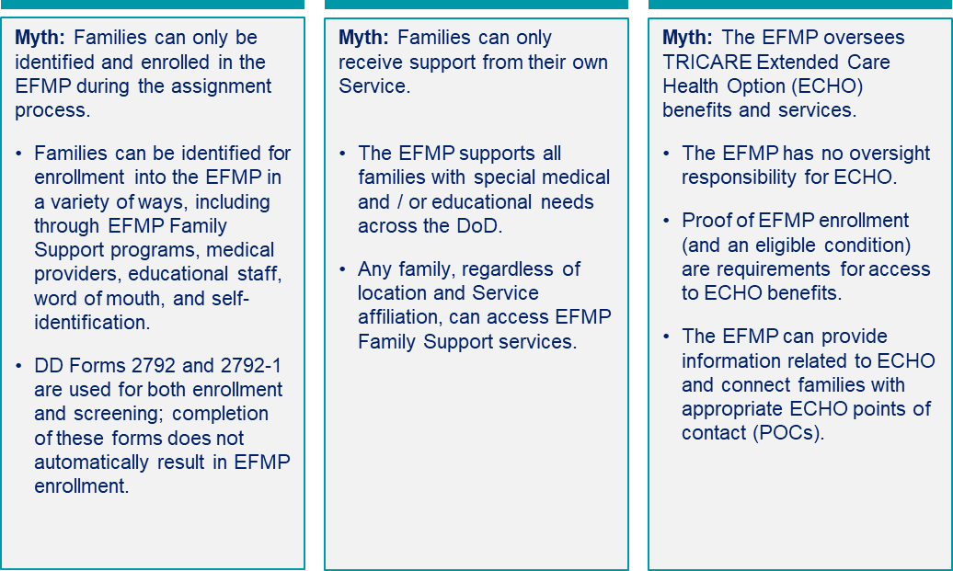
Notes:
The three components of the EFMP are designed to support military families who have a dependent with special medical and/or educational needs and does not limit career progression.
Myths about the program do exist. Some examples identified on the slide include:
First, some families believe that they can only be identified and enrolled in the EFMP during the OCONUS assignment process. However, though many families are identified for enrollment in the EFMP during the assignment process, families can also be referred for potential enrollment by EFMP Family Support staff, medical providers, word of mouth, and self-identification, as well as other installation staff and community members. Though the DD Forms 2792 “Family Member Medical Summary” and 2792-1 “Special Education/Early Intervention Summary” are often seen as enrollment forms only, they may also be used during the assignment process to identify travel concerns that may or may not result in the enrollment of a family member into the EFMP.
Second, some families believe that they can only receive support from their own Service. It is important for families to know that they can access the following core EFMP Family Support services (as stated in DoDI 1315.19 released in April 2017) at any location, regardless of Service affiliation or enrollment status:
Provide information and referral to military families with special needs.
Provide assistance, including non-clinical case management to families of active duty Service members such as the development and maintenance of an individualized Services Plan (SP). The SP will include:
Identification of the family’s current needs, the services they receive, and the support they require.
Documentation of the support provided to the family and follow-on contacts, including case notes.
Refer families who have serious or complicated medical issues to the MHS to request medical case management.
Conduct ongoing outreach with military units, individuals and their families, other service providers, and military and community organizations to promote and understanding of the EFMP and to encourage families with special needs to seek support services when needed.
Provide assistance before, during, and after relocation, including coordination of services with the gaining installation’s EFMP family support services program.
Educate and provide assistance to Service members and their families about EFMP family support services, the enrollment and assignment coordination process, resources, and other topics as appropriate.
Third, some families believe that the EFMP has responsibility for TRICARE ECHO benefits and services. In fact, the EFMP does not provide medical care to families and it has no oversight responsibility for ECHO or medical benefits because ECHO is delivered by TRICARE. It is true that proof of EFMP enrollment and an eligible condition are required in order to access ECHO benefits. EFMP Family Support can provide information about TRICARE ECHO services, connect families to ECHO points of contact, and verify EFMP enrollment status for eligibility purposes.
In order to address the misconceptions and stigma that negatively impact the reputation and effectiveness of the EFMP, standard information will continue to be developed and distributed to communicate the purpose and scope of the EFMP to families and staff.
Optional Myth: Enrollment in the EFMP will limit a Service member’s career progression.
The Marine Corps conducted a study in 2016, indicating that were no negative impacts associated with enrollment in the EFMP. The Marine Corps study showed that Marines in the EFMP remained on active duty slightly longer than their non-EFMP peers and achieved a slightly higher rank. Feel free to go to the Marine Corps’ Manpower and Reserve Affairs website for more information on the 2016 Marine Corps EFMP study: Analysis of the Impact of Exceptional Family Member Program Enrollment on Individual Marine Career Progression and Promotion.
https://www.manpower.usmc.mil/webcenter/portal/FamilyCare

Slide 6
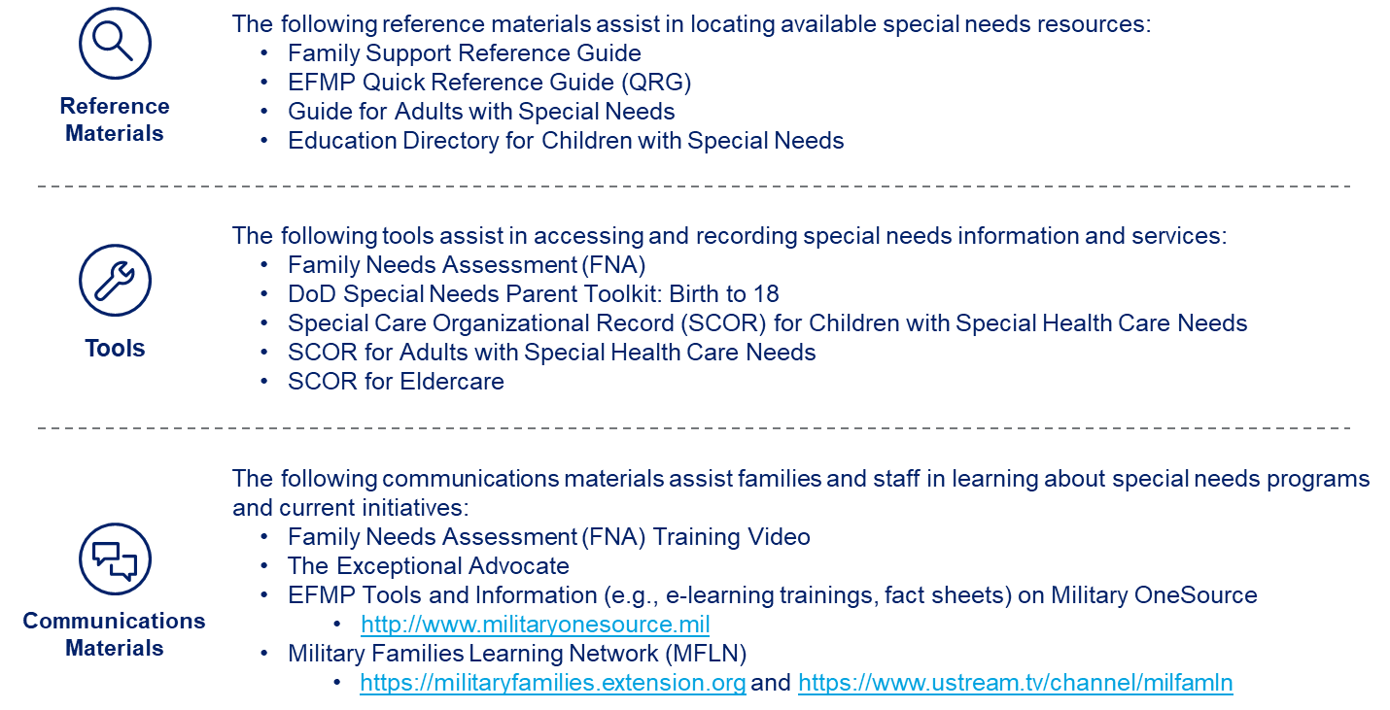
Notes:
All EFMP Family Support staff and families have access to standard resources to assist in navigating DoD special needs programming.
These standard resources include a series of Reference Materials such as the EFMP Quick Reference Guide, Tools such as the Family Needs Assessment, and Communications Materials such as The Exceptional Advocate. Many of these resources are available on Military OneSource and are accessible at every installation, regardless of Service affiliation.
For your reference, please find below the links to the Military OneSource and MFLN websites:
Military OneSource Resources
http://www.militaryonesource.mil/
Military Family Learning Network (MFLN)
https://militaryfamilies.extension.org/
http://www.ustream.tv/channel/milfamln

Slide 7
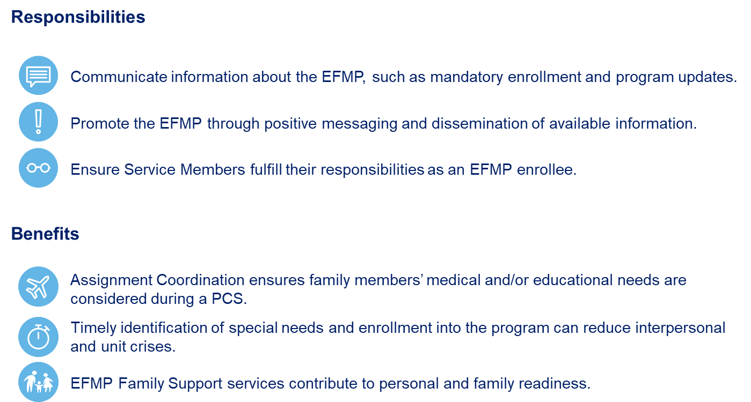
Command Responsibilities and Benefits
Notes:
While certain responsibilities are required with the EFMP, the EFMP can also benefit you. The Assignment Coordination process allows Service Members to focus on mission readiness knowing that their family members needs have been considered during the PCS process. Timely identification and enrollment into the program can reduce family and unit crises. Additionally, EFMP Family Support services are a tool that commanders can use to support the Service Members and families in their command.
[This is an opportunity for the EFMP Family Support staff to elaborate on what they can do for families.]
*Additional information is available on Military OneSource if needed.*

Slide 8
The Service-specific and community information highlights the resources, community partners, demographics, and recent activities and accomplishments at [LOCATION].
Resources & Community Partners
[Placeholder]
[Placeholder]
Demographics of Installation Population
[Placeholder]
[Placeholder]
Recent Activities & Accomplishments
[Placeholder]
[Placeholder]
Notes:
Our installation collaborates with several local resources and community partners, including [PLACEHOLDER].
Here are a few “fast facts” regarding the demographics of our installation population:
[PLACEHOLDER]
[PLACEHOLDER]
We are very proud of our installation’s recent activities and accomplishments, including [PLACEHOLDER].

Slide 9
Contact Information
Feel free to reach out to the points of contact listed below with any questions or comments regarding the EFMP.
Point of Contact #1
[Name]
[Office Address]
[Email Address]
[Phone Number]
Point of Contact #2
[Name]
[Office Address]
[Email Address]
[Phone Number]
Notes:
If you would like additional information about the EFMP, feel free to reach out to the points of contact listed on the slide. Thank you so much for taking the time to meet and we look forward to working with you to support our military families with special needs.

